Slide 1
Point Operators and Filtering
CSE 463 – Computer Vision
Book- Chap. 3, pp. 107

Slide 2
Point operators
Point Operators are simple, foundational image processing transformations
In these operations, each output pixel value depends solely on the corresponding input pixel value
May use some global parameters (e.g., brightness, contrast) for uniform adjustments
Key Characteristics
Independent Pixel Manipulation: Adjusts individual pixels without considering neighboring pixels.
Known in literature as Point Processes (Crane, 1997).

Slide 3
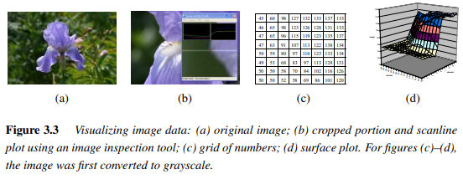
Point operators

Slide 4


Pixel transforms
A general image processing operator is a function that takes one or more input images and produces an output image.
General Image Processing Operator
Takes one or more input images to produce an output image.
Continuous Domain:
Discrete Domain:

Slide 5


Pixel transforms (Contd.)
Point Processes: Contrast and Brightness Adjustment:
Multiplicative and Additive Transformation:
a - Gain (contrast control)
b - Bias (brightness control)
Spatially Varying Gain and Bias:
Used for effects like graded density filters or vignetting.

Slide 6

Pixel transforms (Contd.)
Linear Operations
Superposition Principle:
For linear operations:
Example: Multiplicative gain.
Linear Blend Operator
Image Blending:
α (alpha) varies from 0 to 1 for cross-dissolving or morphing.

Slide 7

Pixel transforms (Contd.)
Non-linear Transform: Gamma Correction
Gamma Correction:
Commonly used with γ (gamma) ≈2.2 to adjust radiance in digital images.

Slide 8
Color transforms
Understanding Color Channels:
Color images are treated as correlated signals due to the connections with image formation, sensor design, and human perception.
Brightening an Image:
Adding a constant value to each RGB channel increases brightness.
However, this may unintentionally affect hue and saturation.
Maintaining Perceptual Qualities:
Use chromaticity coordinates or color ratios for accurate adjustments.
Example: Adjust luminance (Y) to brighten the image while preserving hue and saturation.
Color Balancing:
Corrects lighting effects (e.g., incandescent lighting).
Can use:
Scale Factors for each channel.
3 × 3 Color Twist Matrix for more complex transformations, such as converting between color spaces (e.g., RGB to XYZ).

Slide 9
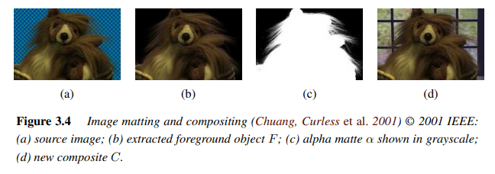
Color transforms (Contd.)
Image Matting and Compositing
(a) Source Image: Original image with background.
(b) Extracted Foreground Object: Isolated object for compositing.
(c) Alpha Matte (Grayscale): Defines transparency levels for seamless blending.
(d) New Composite: Final image with foreground object over a different background.

Slide 10
Alpha-Matted Color Images
Alpha Channel (Opacity)
Alpha-Matted Image: Combines RGB channels with an alpha channel (α) for opacity.
α = 1: Fully opaque (inside object)
α = 0: Fully transparent (outside object)
0 < α < 1: Smooth transitions on object boundaries to avoid visual artifacts (e.g., "jaggies").
Advantages
Allows for smooth blending and layering of objects in composite images.

Slide 11

Compositing Formula – The Over Operator
Over Operator (Porter & Duff, 1984)
Formula:
C: Composite image, B: Background image, F: Foreground image
Attenuates background and blends in the foreground using the alpha channel.
Purpose
Ensures seamless integration of the foreground onto the background without harsh edges.

Slide 12
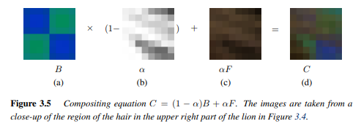
Compositing Formula

Slide 13
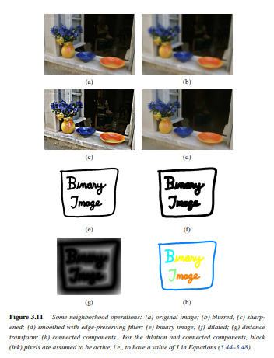
Image Filtering

Slide 14

Linear Filtering
Linear filtering is a process that modifies pixel values based on neighboring pixels.
Used for soft blur, sharpening, edge enhancement, and noise reduction
Linear Filter: Output pixel value = weighted sum of neighborhood pixels.
Formula:
Filter Coefficients: The weights (kernel or mask values) applied to neighborhood pixels.

Slide 15



Linear Filters and Correlation
The entries in the weight kernel or mask h(k, l) are often called the filter coefficients. The above correlation operator can be more compactly notated as
A common variant on this formula is
In convolution, the sign of the offsets in 𝑓 is reversed, making ℎ the impulse response function, which reproduces itself when convolved with an impulse signal.

Slide 16

Convolution Operator
Similar to correlation but with reversed offsets.
This Equation shows a shift-variant convolution, where the kernel h(k, l; i, j) changes with pixel location, useful for depth-dependent blur.
Both shift-variant and shift-invariant convolutions can be expressed as matrix-vector multiplications by converting 2D images to raster-ordered vectors.

